Slide 1
Wondertron Package
By: James and Bella

Slide 2
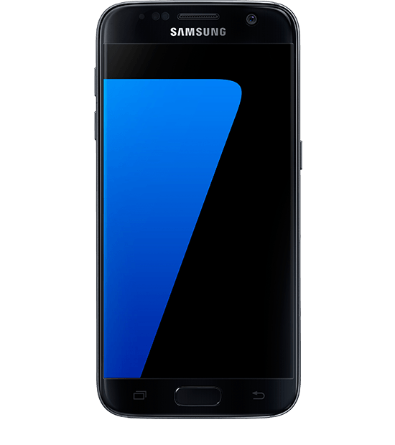
First Modern item
The first item we would send to the planet Wondertron is an iphone. An iphone is a rectangular object that let’s you talk to people that are not actually with you. It will let us contact other aliens on that planet. This will also make life much more easier by allowing the aliens to contact us, as well as letting them contact each other on their own planet, so they can give each other updates. Afterwards, they can give us updates on how they like the new phone

Slide 3
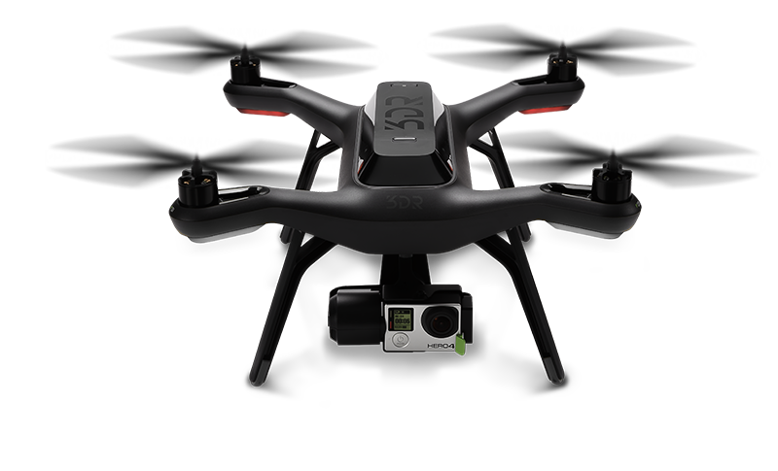
Second Modern item
The second item we would send to Wondertron is a drone. We would send a drone so the aliens could deliver things to other aliens that are too far. For instance if the place was to far the drone would deliver the package faster than a delivery center or by yourself and if it is important or very fragile there is a better chance that it would not be broken. Therefore drones have a better chance of delivering a package faster and safer.

Slide 4
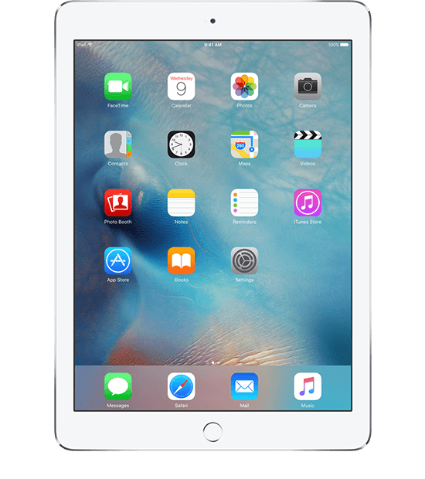
Third Modern Item
The third item we would send to the planet of Wondertron is an ipad. We would send an ipad because it’s basically a bigger version of a phone the aliens could use. It would have several of the same benefits a phone would have but with a larger screen which the aliens would probably enjoy.

Slide 5
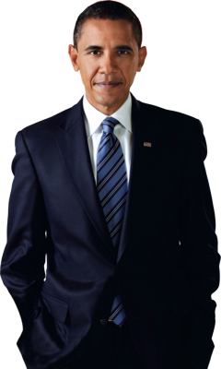
Important events in America
One event I think is an important event that happened in America is when Former President Barack Obama elected as President of the United States. This was an important event because this was the first time an African American was elected as the President. At his inauguration 1.8 million people showed up to see Former President Obama take the Oath of Office. Even if people didn’t agree with some things he said he was one of the Presidents who had a record amount of people come to an inauguration.

Slide 6
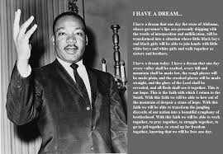
Important events in America
Another important event I think the Wondertron aliens should know is when Martin Luther King Jr. gave his I have a dream speech. This moment was important because this speech encouraged to protest against.

Slide 7
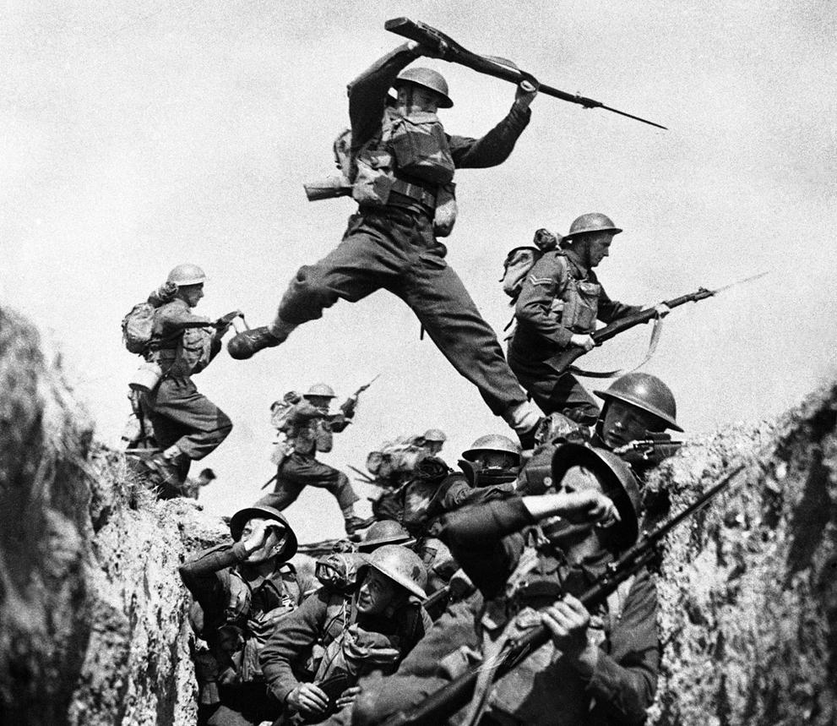
World War 2
World war 2 was a very important but, sorrow filled event that was important to the world. It is important because it gave some countries power, like the U.S., but some countries lost power like Japan.

Slide 8
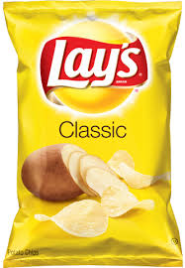
First food
The first food we would send to the Wondertron aliens is a bag of lay chips. We would send this because they are one of a kind and they are always good.

Slide 9
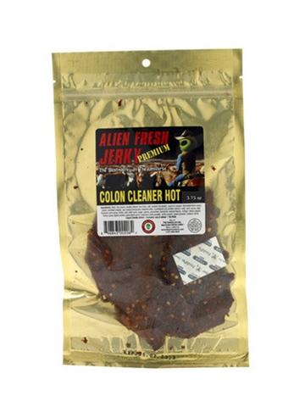
Second food
The second food we would send is a bag of alien fresh jerky. We would send this because it is the best jerky in the universe on the package. We would send the original flavor because that’s the base of all the other flavors.

Slide 10
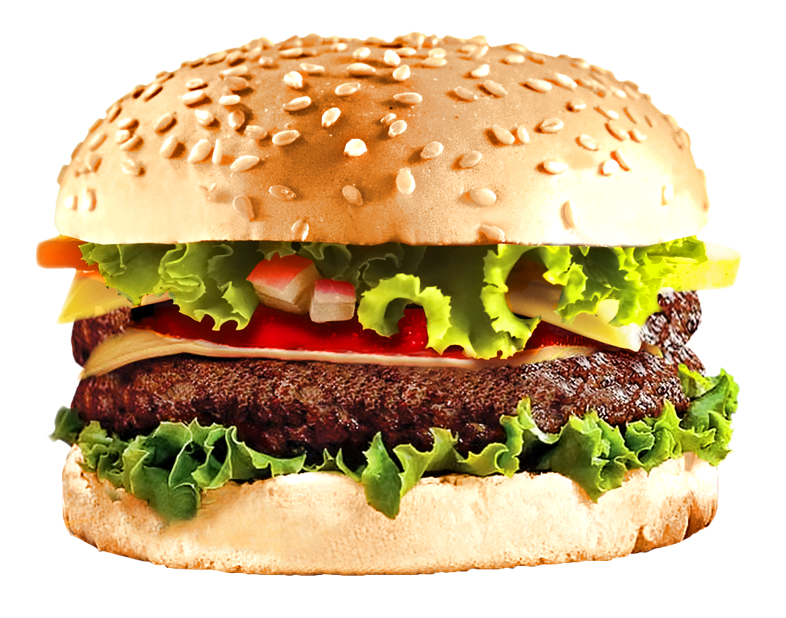
Third food
The second food we would send is a hamburger. We would send this because it is always ready and everyone likes them.

Slide 11
Random thing
A random thing we would send them is a thesaurus. It will help them spell words and think of better ones.

Slide 12
Second random thing
The second random thing I would send is a plant. A plant will help freshen the air so they can breath better.

Slide 13
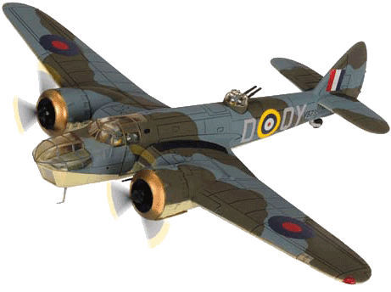
Third random item
The third random item we would send is a model plane because the discovery of human flight was very crucial because a lot of people need to fly across the world for like business trips or vacations.

Slide 14
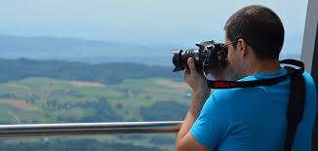
Another human thing
Another thing that people do is take pictures. I think people take pictures so they can remember the moment.

Slide 15
Third human thing
The third human thing we would send is a birthday card to show we celebrate birthdays.

Slide 16
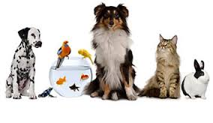
Third human thing
One thing people do on earth is have pets. They have pets so they can have company.

